Slide 1
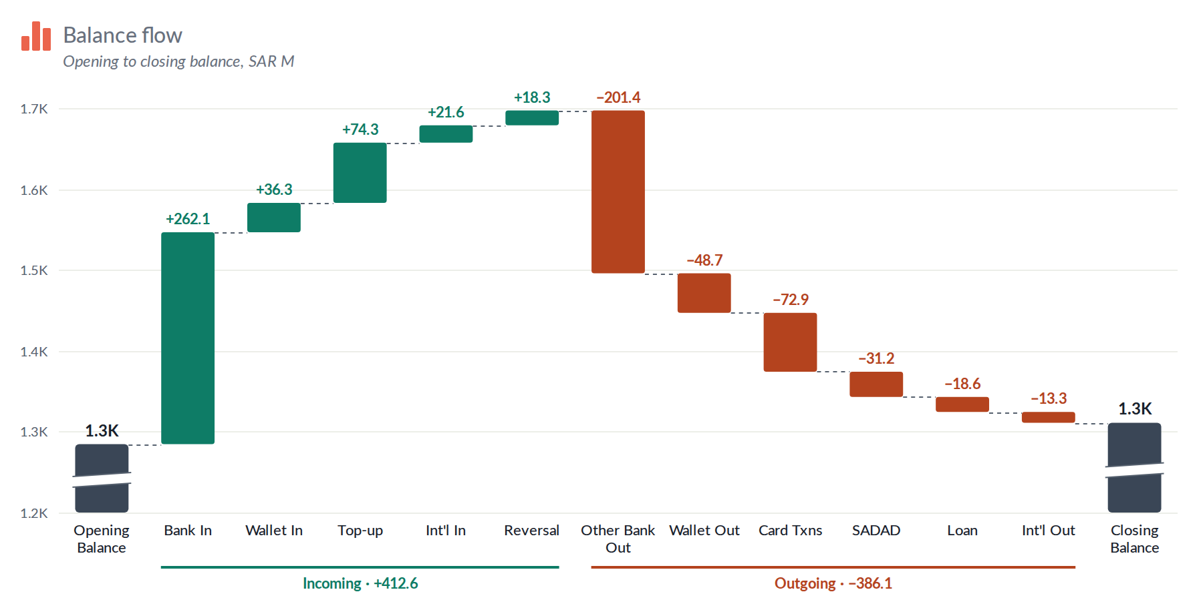
Waterfall for Tableau
Builder guide: add the extension, drop your measures and format every bar, group and label
ilyas coban
Notes:
This deck is for people who build Tableau dashboards. It covers adding the Waterfall extension, which measures go on which tile, the right-click and Format options, and what to do when the chart doesn’t look right.

Slide 2
What the chart shows
1
Header
Icon, title and explanation
1
2
Start bar
Opening value, stands on the axis
4
3
Increases
Float up from the running total
4
Decreases
Float down from the running total
3
6
2
5
Group lines
Runs of ups and downs with totals
7
6
End bar
Closing value, dropped or calculated
5
Clipped marker
Bar is longer than it looks
7
Notes:
Seven parts. Every bar shows its value on top, and connector lines link each bar to the next. The clipped marker appears when the axis does not start at zero, so the Start and End bars are drawn shorter than their true length.

Slide 3



Before you start
Tableau 2024.2 or later
The extension is reachable
You have waterfall.trex
Viz extensions run in Tableau Desktop and in web authoring on Tableau Server or Cloud.
waterfall.trex points to cobani.github.io. On Tableau Server that URL, or your own copy, must be on the extension safe list.
This small manifest file tells Tableau where the card lives. Get the server version from your admin.
Notes:
The shipped manifest loads the chart from GitHub Pages. If your Tableau Server cannot reach the internet, your admin hosts a copy internally and gives you a manifest that points to it. The local dev preview at localhost:8767/dev/preview.html shows the chart with sample data, without Tableau.

Slide 4
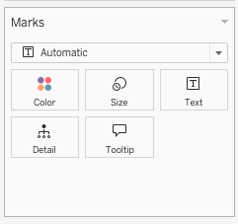
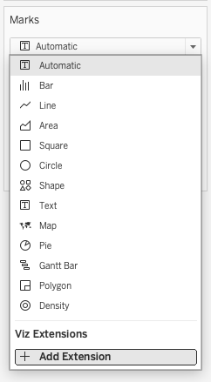
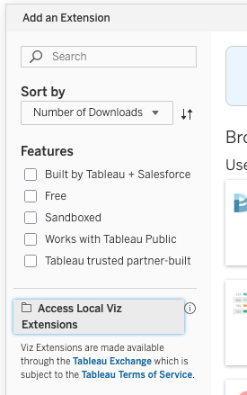
Add the extension to a worksheet
1
Open the mark type menu
On the Marks card, click the dropdown that says Automatic.
1
2
Choose Add Extension
It sits at the bottom of the list, under Viz Extensions.
3
3
Pick kpiCard.trex
Choose Access Local Extensions, browse to the file and open it.
2
4
Allow it if asked
The card appears with a hint telling you which fields to drag.
Notes:
If your organisation publishes the extension on Tableau Server, Add Extension may list it directly. Otherwise use Access Local Extensions and pick the .trex file. If you are given a new .trex later, remove the extension and add it again: Tableau reads the manifest only when it is added.

Slide 5
Fill four tiles on the Marks card
Marks
Start one measure, the opening value.
Changes drop each measure separately, up to 30. Bars follow the order of the pills; drag a pill to reorder.
End optional. Leave it empty and End = Start + changes.
Breakdown optional dimensions that split the change bars into segments.
Waterfall ▾
Start
SUM(Opening Balance)
Changes
SUM(Bank In)
SUM(Wallet In)
SUM(Other Bank Out)
+ 8 more, one pill each
End
SUM(Closing Balance)
One bar per pill, in tile order
Breakdown
Account Type
Notes:
Measures are green pills, the breakdown dimension is a blue pill. If Tableau turns the changes into Measure Names and Measure Values, the extension pivots them back, so there is nothing to fix.

Slide 6
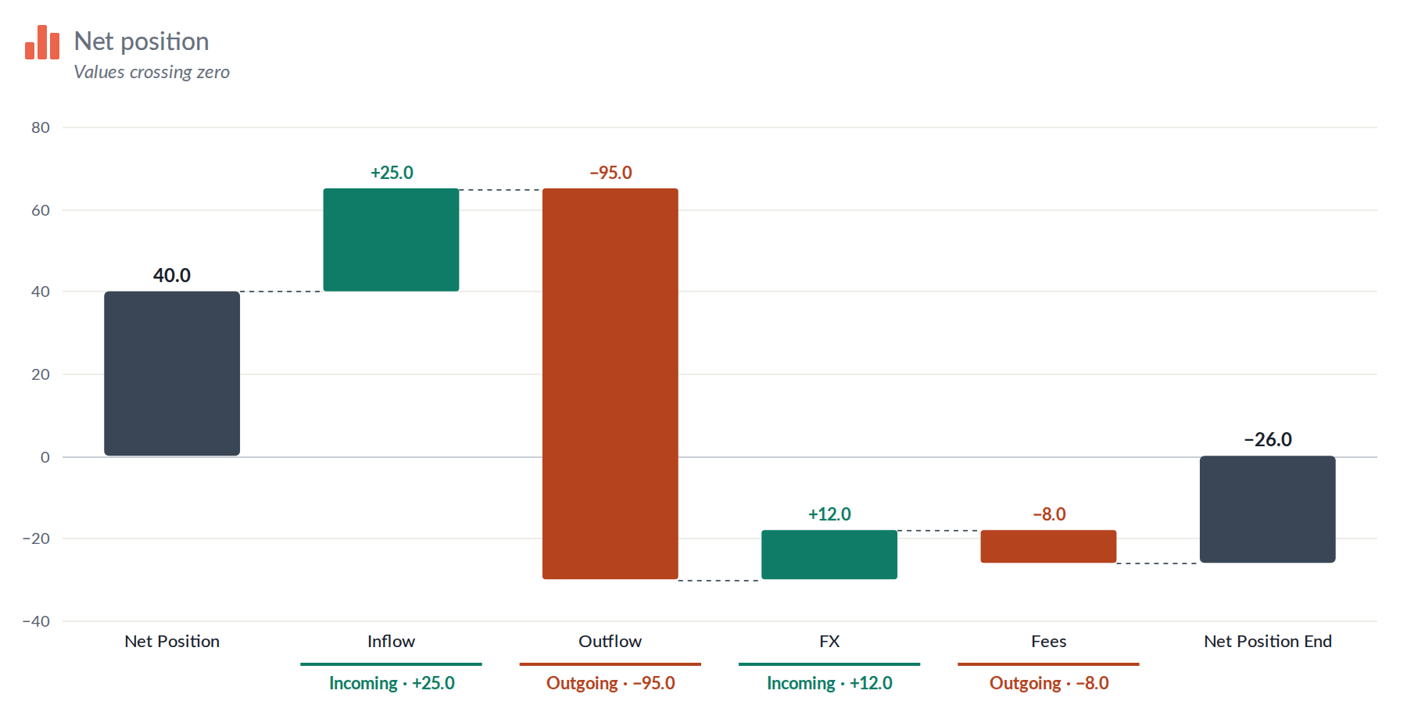
Getting the numbers right
If your data… | Then
stores outflows as positive amounts | Tick Invert sign for those bars (Bars tab).
has an End that doesn’t match | The End tooltip shows the difference.
arrives as Measure Names / Values | Nothing to do; it’s pivoted back.
crosses zero | Bars go below the axis, as on the right.
gets a renamed measure | That bar starts from the defaults again.
Net position: values crossing zero
Notes:
Change-bar settings are stored per measure, by the pill’s name, for example SUM(Bank In). Renaming or swapping that measure starts its bar from the defaults.

Slide 7

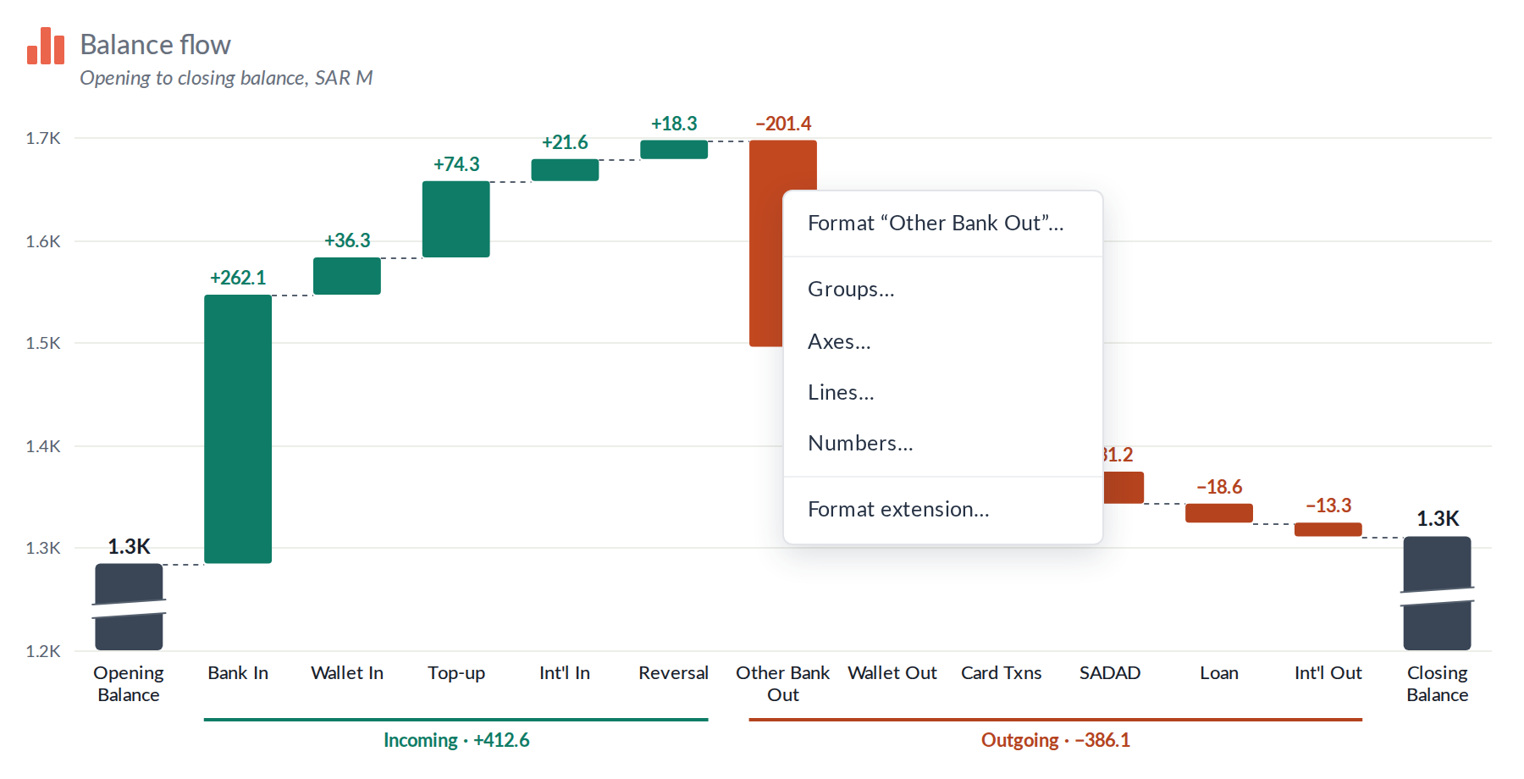


Three ways into the settings
Format Extension
The button at the bottom of the Marks card opens the full dialog.
Right-click a bar
Format that bar, or jump to Groups, Axes, Lines or Numbers.
Double-click a bar
Opens that bar’s settings directly.
Changes show live. Cancel undoes everything since the dialog opened; Reset tab restores that tab’s defaults.
Notes:
Viz extensions can’t add entries to Tableau’s own right-click menu, so the chart draws its own menu when you right-click a bar. It can be turned off in Bars, All bars, Right-click menu.

Slide 8
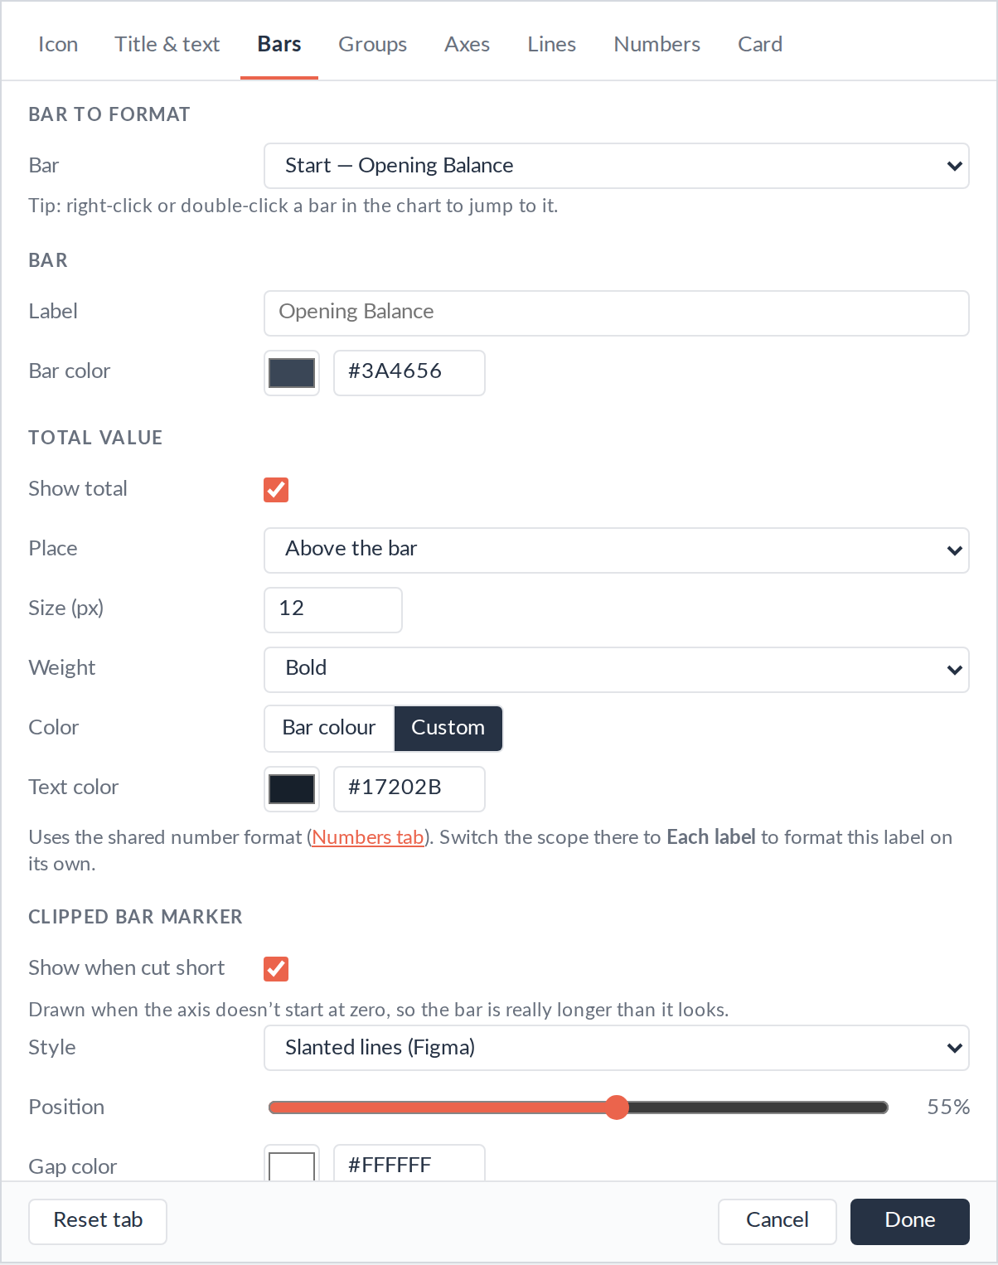
Bars: style one bar or all of them
Pick a bar: Start, any change, or End.
Bar: label, colour (Increase / Decrease or custom), invert sign.
Total value: show or hide, place it above, inside or below, and style it.
Clipped marker: slanted lines, zigzag or gap, position and colours.
All bars: width, corner radius, colours, calculate End, tooltip, right-click menu.
Apply these settings to all changes copies one bar’s look to every change bar.
Notes:
The bar picker at the top lists every bar by its label. Double-clicking a bar in the chart opens this tab with that bar already picked.

Slide 9
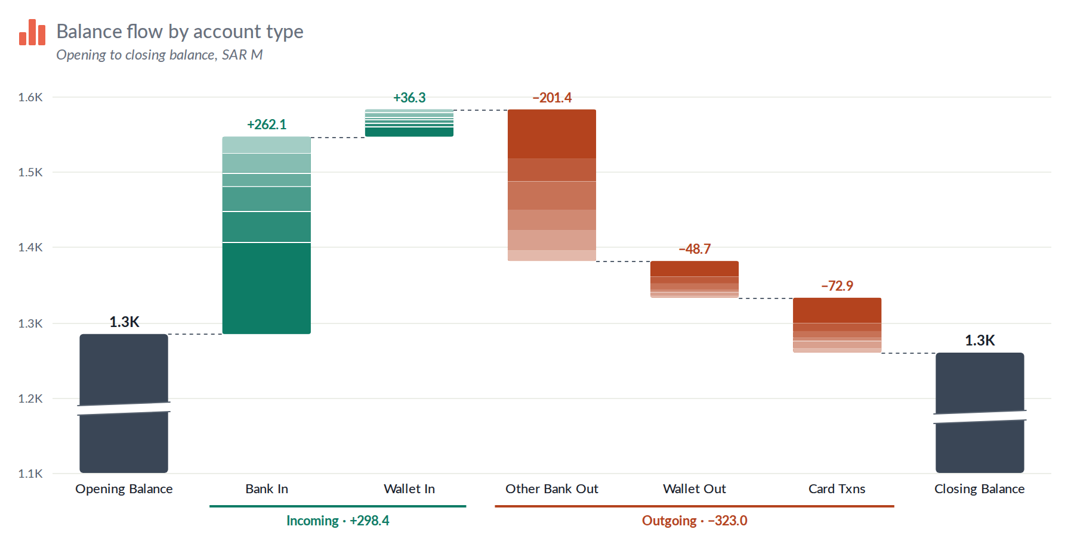
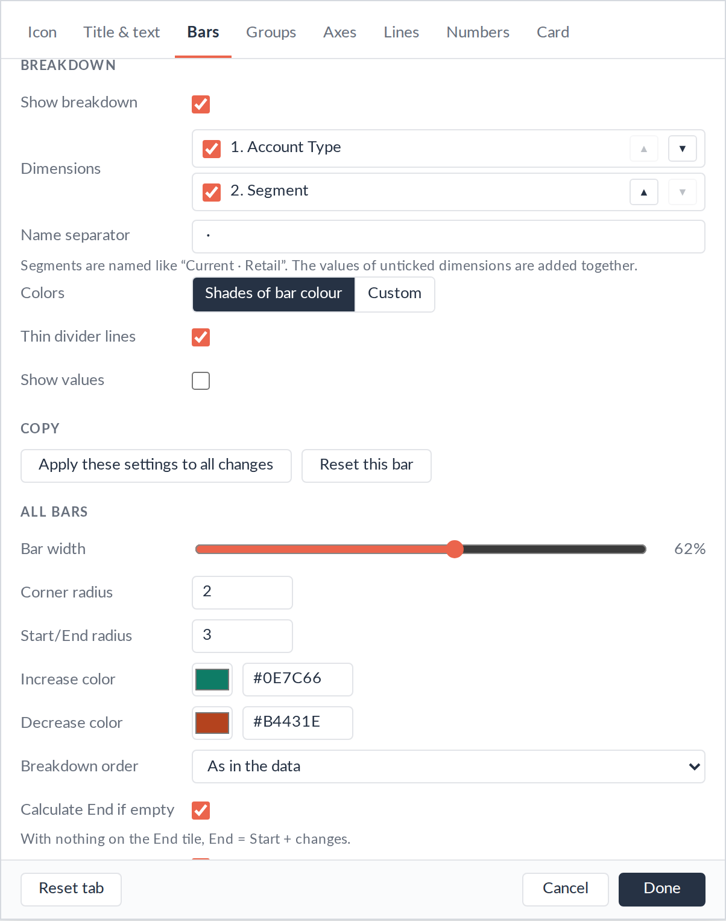
Breakdown: split change bars into segments
1
Drop one or more dimensions on Breakdown
2
Bars tab: pick a change bar, tick Show breakdown
3
Tick which dimensions it uses, set their order (▲ ▼)
4
Colours: shades of the bar colour, or custom
Notes:
Segments are named like "Current · Retail". Values of unticked dimensions are added together. Each segment can show its value and name, inside or beside the bar, and small segments can hide their labels.

Slide 10
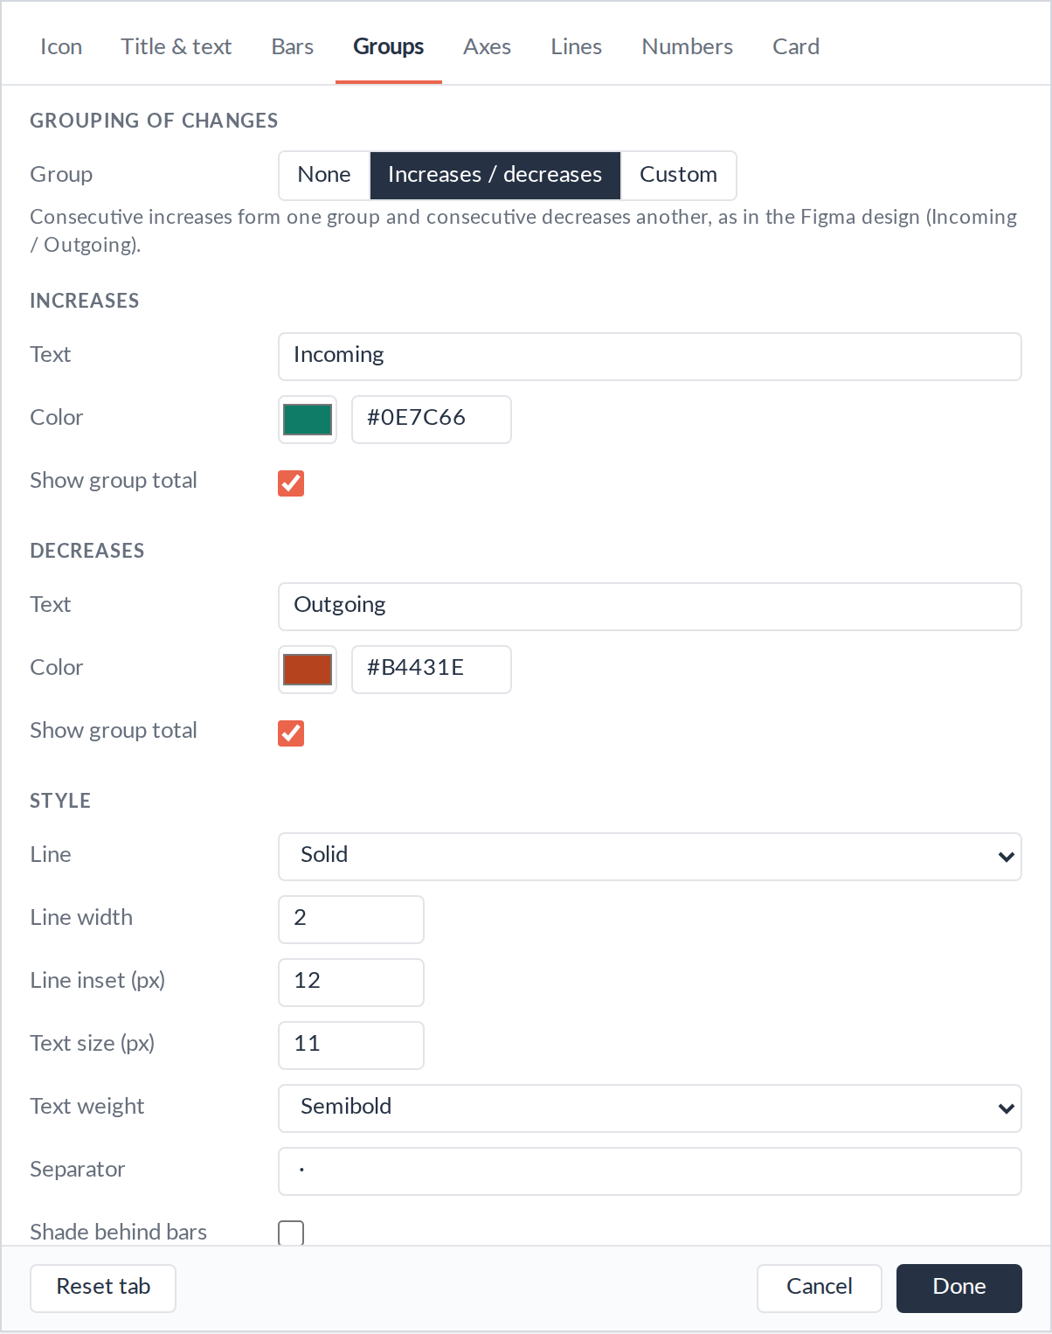
Groups: summarise runs of changes
None
Increases / decreases
Custom
Increases / decreases: each run of ups or downs gets a line and a total, like "Incoming · +412.6".
Custom: name your own groups and assign bars to them.
Per group: text, colour, show total.
Style: solid, dashed, dotted or bracket lines, width, text size, optional shading.
Incoming and Outgoing group lines under the bars
Notes:
Group lines sit below the bar labels. Shading behind the bars is off by default; turn it on to make the groups stand out further.

Slide 11
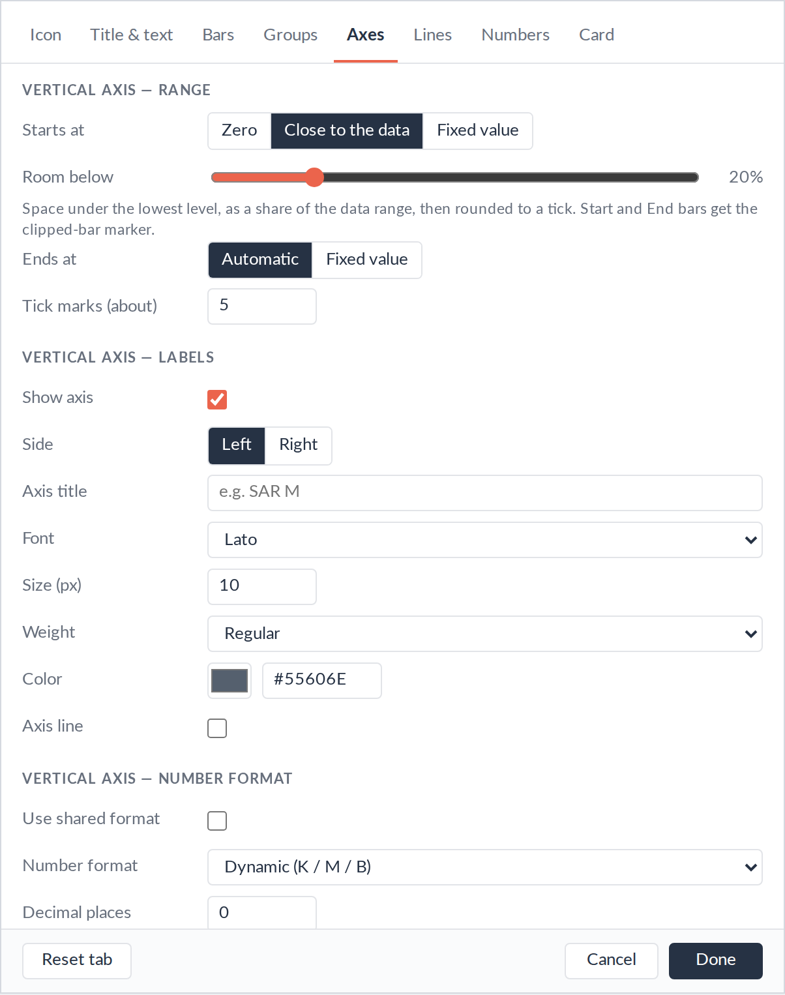
Axes: where the bars start
Starts at | Effect
Close to the data | Small changes stay visible. Start and End are cut short and get the clipped marker.
Zero | Full-length bars, no markers. Small changes look tiny.
Fixed value | The same axis on every filter.
Vertical: maximum, tick count, side, title such as SAR M, font, own number format.
Horizontal: labels flat (wrapping), angled or vertical, max lines.
Notes:
Close to the data, the Figma default, starts the axis a little below the lowest running total, rounded to a tick. Room below sets how much space to leave, as a share of the data range.

Slide 12
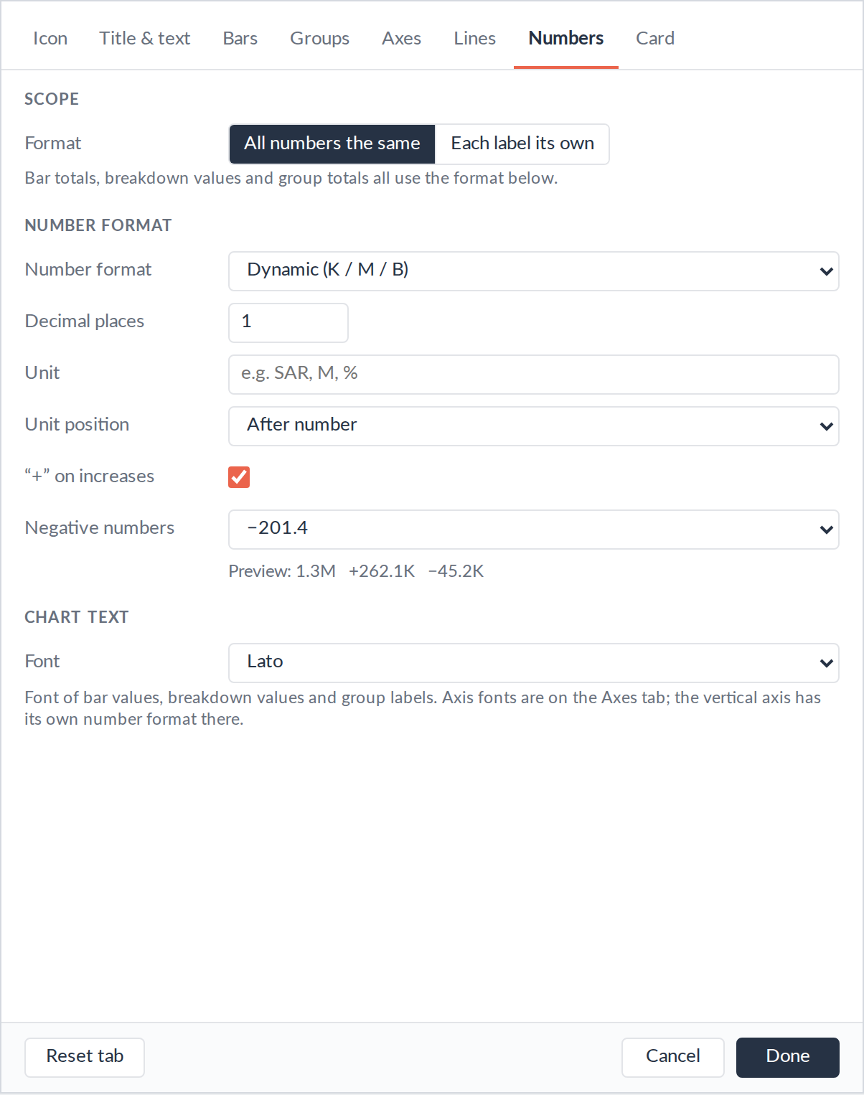
Numbers: one format or one per label
Setting | Shows as
Dynamic (K / M / B), 1 decimal | 1.3K +262.1M
"+" on increases | +262.1
Negatives: − / - / ( ) | −201.4 -201.4 (201.4)
Percentage, 0–1 ratio | 45.2%
Unit after the number | 262.1 SAR
All numbers the same uses one format everywhere. Each label its own gives every total, breakdown and group total its own editor.
Notes:
The formats are the same as in the KPI Card: K, M, B, Dynamic, full number, Percentage, Percentage dynamic and workbook format. Copy this format to every label resets all per-label formats to the shared one.

Slide 13
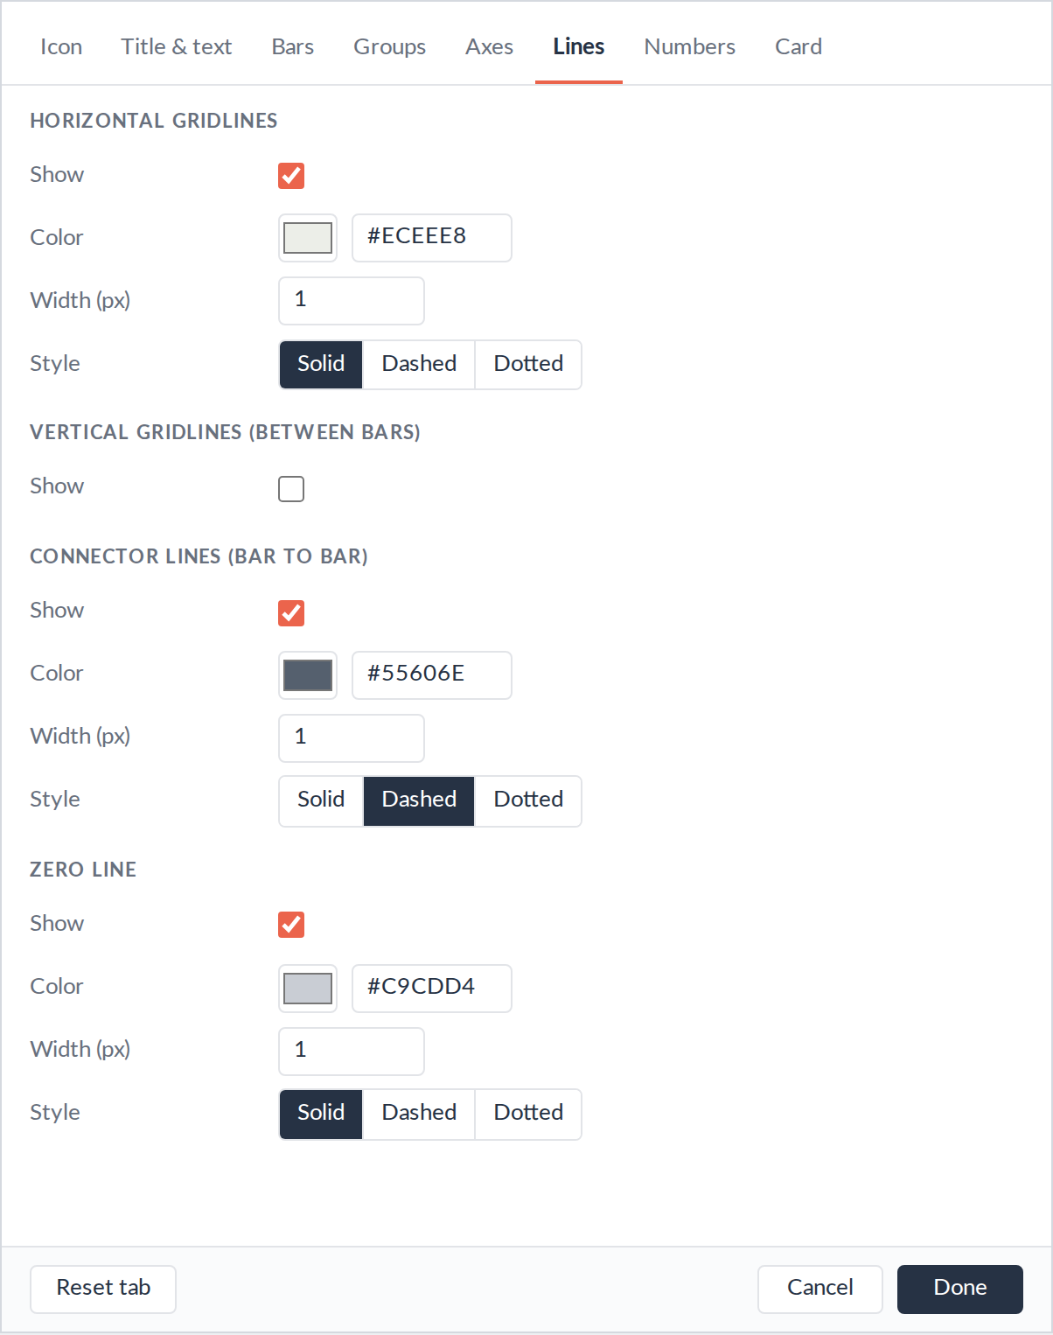
Lines: gridlines, connectors and zero
Horizontal gridlines
On by default, light grey
Vertical gridlines
Between bars, off by default
Connector lines
Dashed links from bar to bar
Zero line
Marks zero when bars cross it
Each one: show or hide, colour, width, and solid, dashed or dotted.
Notes:
Keep connector lines on: they show where each bar starts. Turn the zero line on whenever values can go negative.

Slide 14
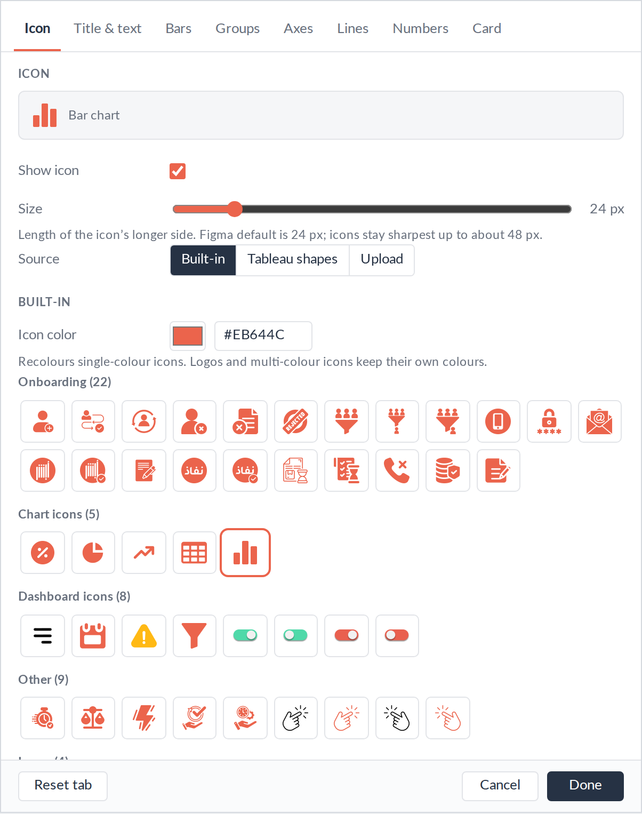
Header and card: same as the KPI Card
Icon: built-in Figma icons, Tableau shapes or upload; size and colour.
Title & text: an empty title shows "Start → End"; the explanation is optional.
Card: padding, space above the chart, dashed divider, background colour and opacity.
To see the dashboard through the chart
1
Worksheet: Format → Shading → None
2
Dashboard object: Background → None
3
Container: Background → None
Notes:
The Icon, Title & text and Card tabs work exactly as in the KPI Card extension, so dashboards that use both look consistent. The background is transparent by default.

Slide 15
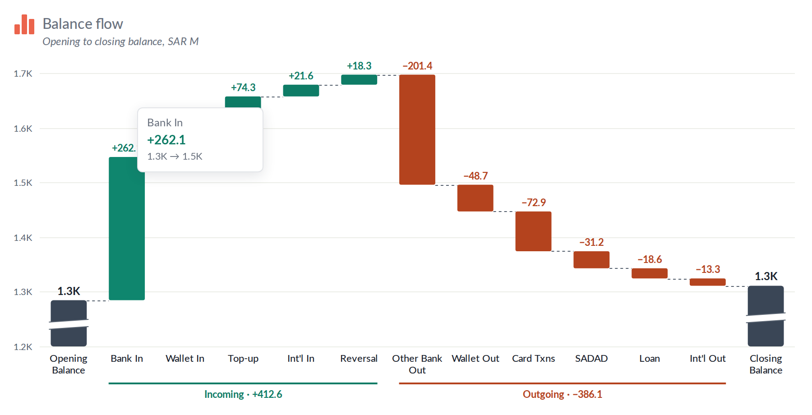
Hover a bar for details
1
Bar name
the measure’s label
2
Change
formatted like the bar’s total
3
Running total
from → to, e.g. 1.3K → 1.5K
4
End check
the End tooltip shows any difference
Turn it off in Bars → All bars → Tooltip.
Notes:
The End check catches data problems: if the End measure doesn’t equal Start plus all the changes, the tooltip on the End bar shows by how much.

Slide 16
If the chart doesn’t look right
What you see | What to do
"Drag measures onto Start, Changes…" | Add measures to the tiles.
Changes in the wrong order | Drag the pills on the Changes tile into order.
Outflows going up | Tick Invert sign for those bars.
End tooltip shows a difference | Check filters, or leave End empty to calculate it.
Start and End cut short, with a marker | Set Axes → Starts at → Zero for full bars.
A bar lost its formatting | Its measure was renamed or swapped. Format it again.
Blank chart or "Could not load…" | Check the URL is reachable and on the safe list.
New .trex changes don’t appear | Remove the extension and add it again.
Notes:
Most issues come from how the measures are dropped: each change needs its own pill on the Changes tile.

Slide 17
Five-minute checklist
1
Add Extension → waterfall.trex
2
Drop Start, each change, and End
3
Invert sign on outflows if needed
4
Type the title; pick the number format
5
Choose groups and the axis start
Questions: ilyas coban · linkedin.com/in/ilyascoban
Notes:
Publish when you’re done: every setting is saved in the workbook. On Tableau Server the extension’s URL must be on the safe list for viewers to see the chart.

